Slide 1
Employee Data Analysis using Excel
STUDENT NAME: P.DEEPAK
REGISTER NO:122204359
DEPARTMENT: B.COM(CS)
COLLEGE: GOVERNMENT ARTS AND SCIENCE COLLEGE PERUMBAKKAM.

Slide 2
PROJECT TITLE
Employee Performance Analysis using Excel

Slide 3


AGENDA
Problem Statement
Project Overview
End Users
Our Solution and Proposition
Dataset Description
Modelling Approach
Results and Discussion
Conclusion
3/21/2024 Annual Review

Slide 4

PROBLEM STATEMENT
problem statement is a concise and clear description of an issue or challenge that needs to be addressed. It serves as a roadmap for problem-solving and decision-making, helping individuals and teams define the scope of their work and focus on the most critical aspects of a problem.

Slide 5

PROJECT OVERVIEW
.
project overview is a concise document that summarizes the key elements of a project, including its goals, objectives, schedule, budget, and resources. It's a useful tool for keeping everyone involved in a project informed and aligned, and can be used as a reference throughout the project's lifecycle.

Slide 6

WHO ARE THE END USERS?
Ultimately, an end user is a person who will use a good or service. End users are consumers. They do not produce, sell, support, or maintain the product. These people often do not have the same technical understanding as the product’s designers and developers. It’s critical for a business to consider the end-user experience while developing products and services. User i

Slide 7

OUR SOLUTION AND ITS VALUE PROPOSITION
A value proposition should clearly explain how a product or service fills a need, and why it's better than similar products on the market. It should also appeal to a customer's strongest decision-making drivers.

Slide 8
Dataset Description
Keep the description to five paragraphs or less The first paragraph should be a brief description of the dataset Use markdown for links and bullet points Avoid duplicating information from other fields in the form

Slide 9

THE "WOW" IN OUR SOLUTION
presentation that's considered to have a "wow factor" is one that's engaging and memorable, and that goes beyond static slides. Here are some tips for creating a presentation with a "wow factor":
Consider the audience: Tailor your presentation to your audience and connect with each member.
3/21/2024 Annual Review
9

Slide 10
MODELLING
Modeling involves making a representation of something. Creating a tiny, functioning volcano is an example of modeling. Teachers use modeling when they have a class election that represents a larger one, like a presidential election. Modeling is anything that represents something else, usually on a smaller scale.
10

Slide 11
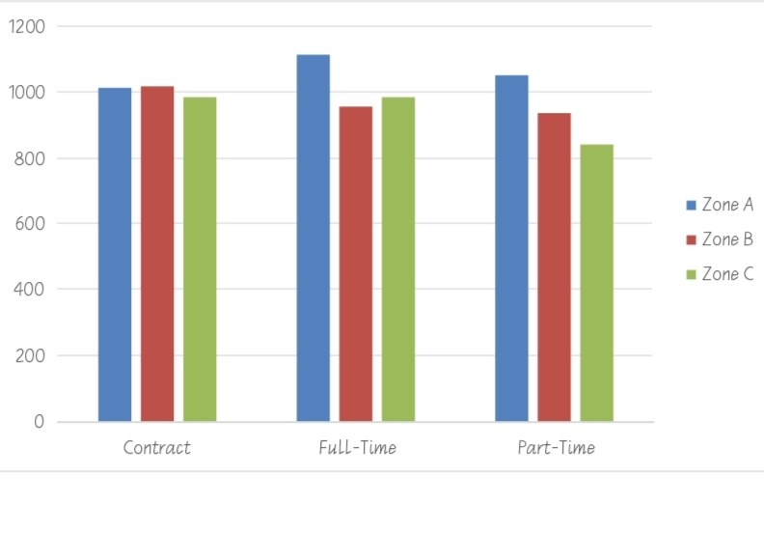
RESULTS
11

Slide 12
conclusion
Summarize key points: Highlight the main points and takeaways from your presentation. Reinforce your message: Echo the core message or objective of your presentation. Include a call to action: Provide a clear and specific action for the audience to take after the presentation. Leave a lasting impression: Craft a memorable closing statement that leaves a positive final impression.

